Slide 1
ReD sables
That won’t hurt you

Slide 2
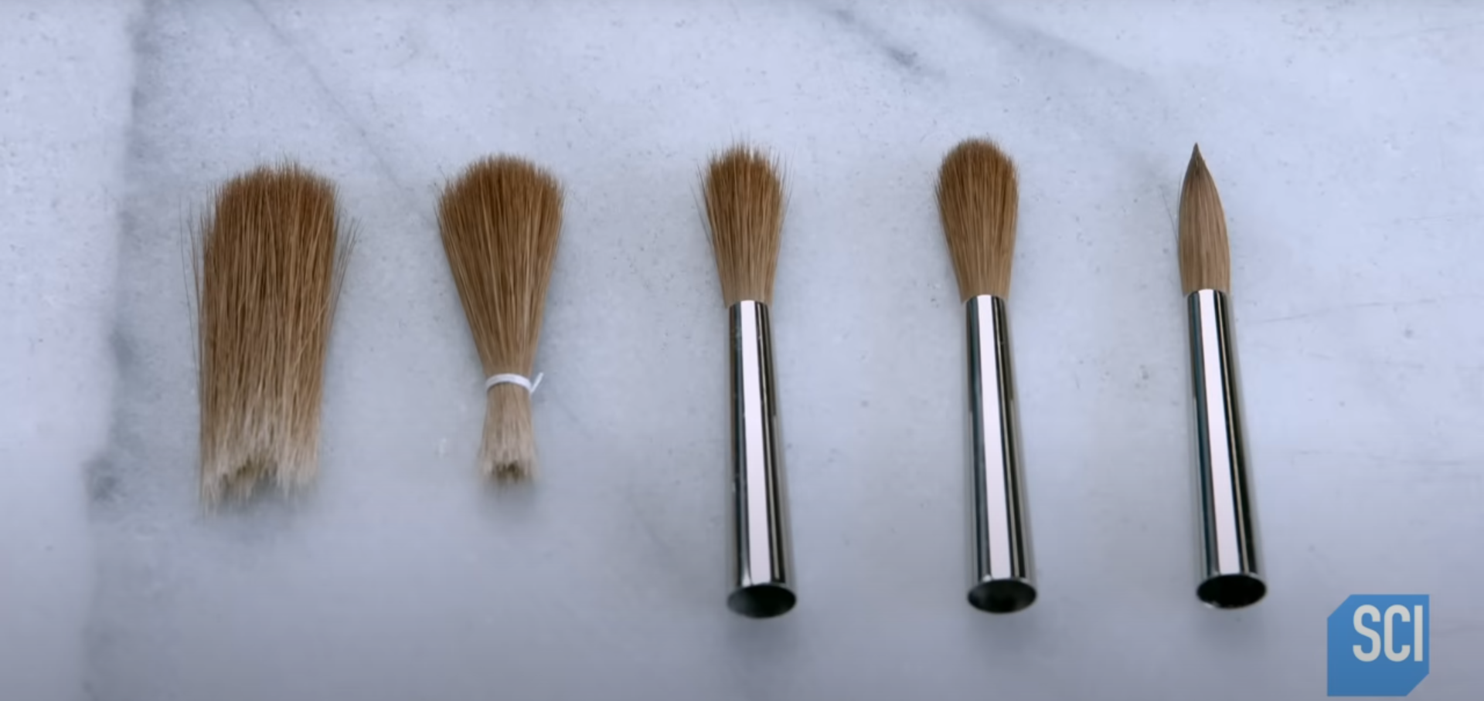
What is a Red sable exactly
Kind of a paint brush, known for spreading paint thinly and evenly

Slide 3
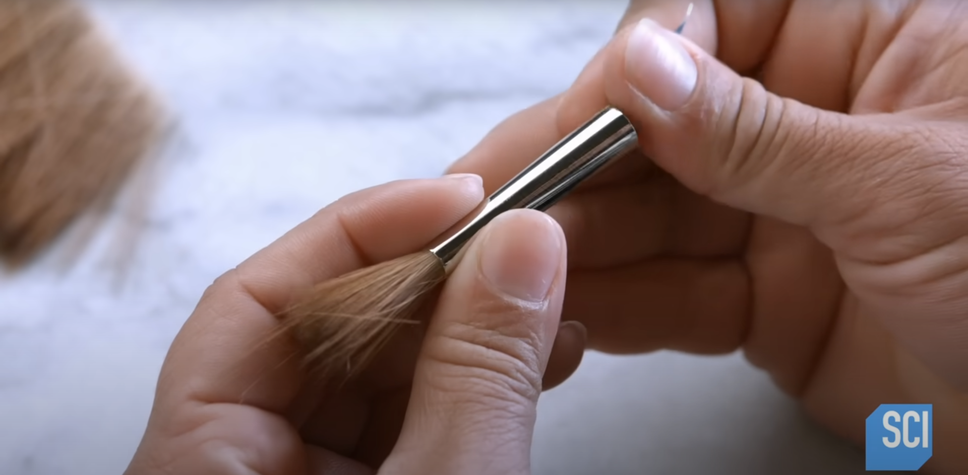
How they are made
Those brushes are primarily made by hand. If brush is too loose – craftsman adds some hairs, when it becomes too tight – removes a couple.

Slide 4
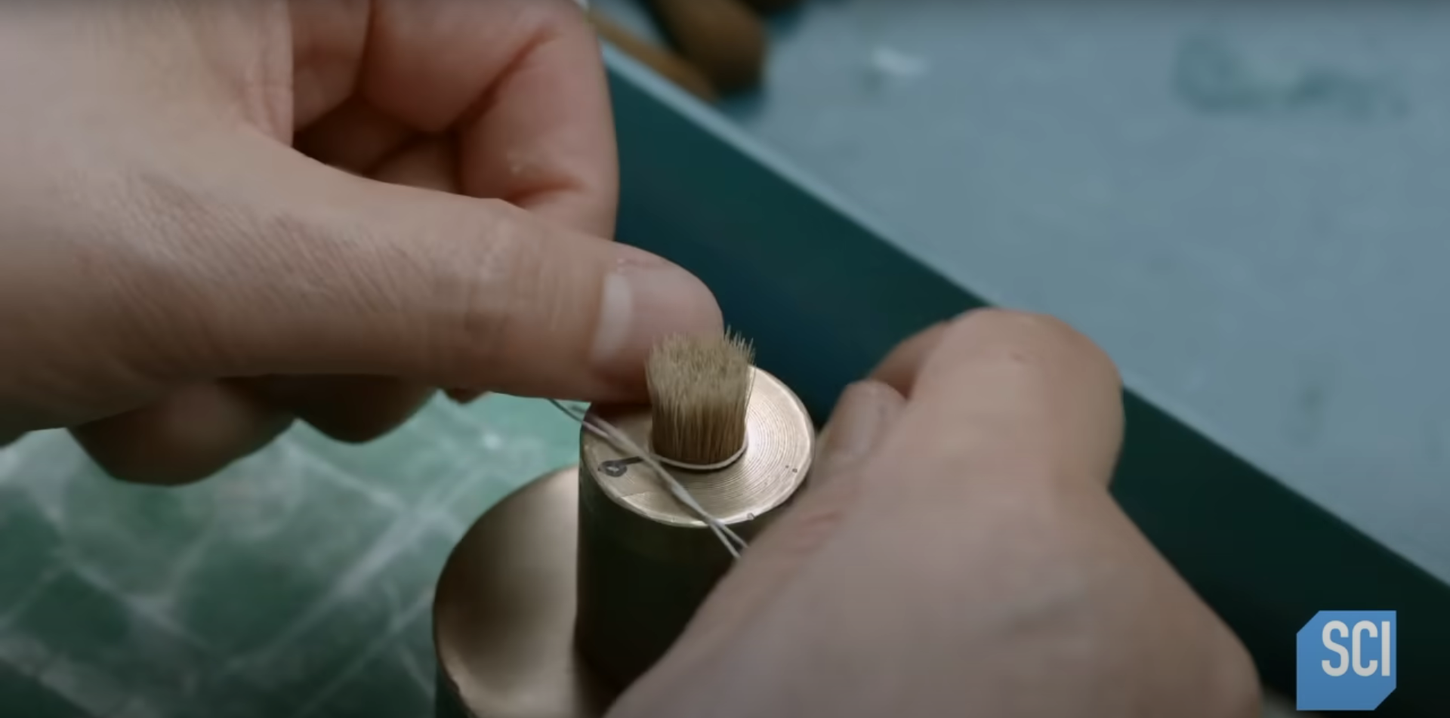
Selective Tension
Tension depends on a shape, so tension is provided with a prepared size-measured mold

Slide 5
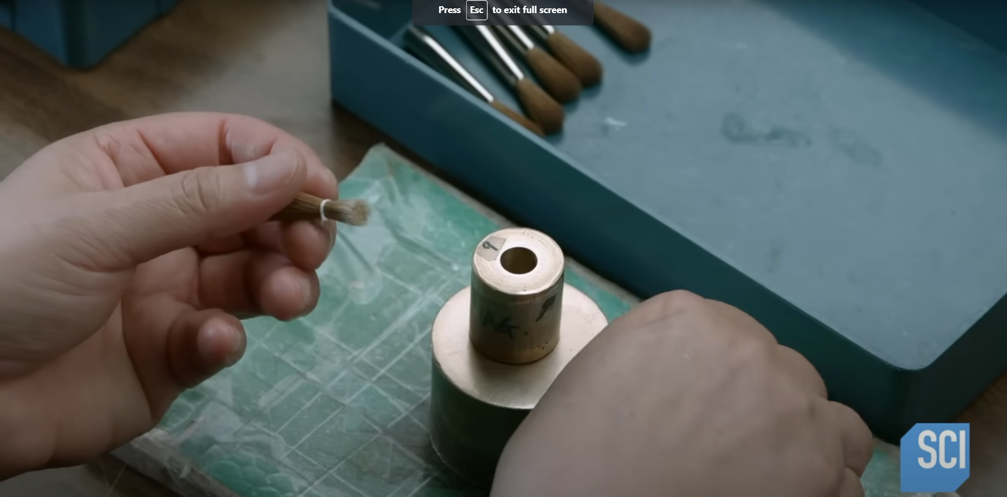
Tightening all together
To keep estimated hairs together, craftsman fixates them with a rope-like thing

Slide 6
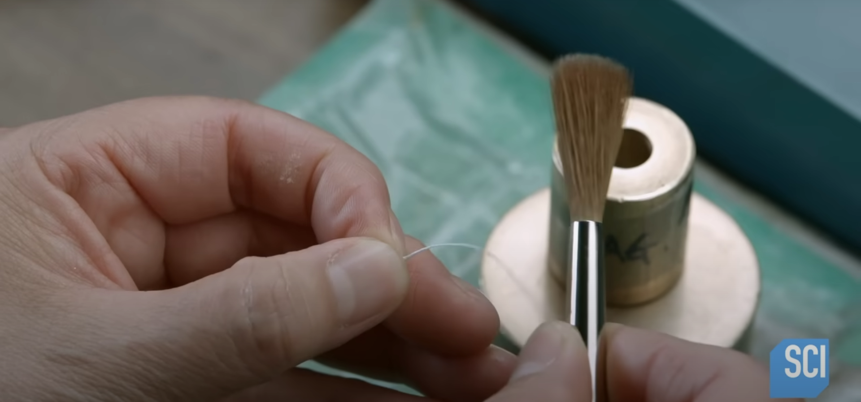
String does not stay long
String is put away, when hairs are put in the metal tube

Slide 7
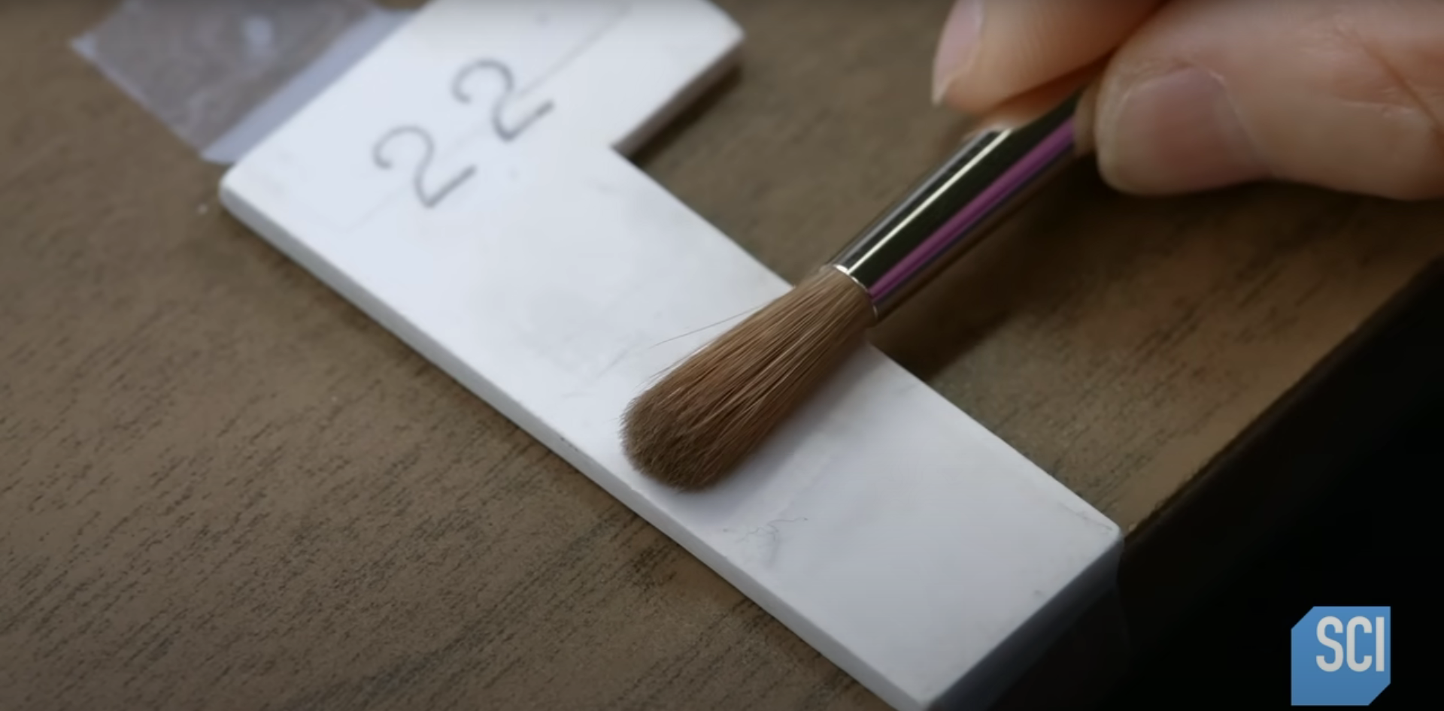
Stray hairs away
Not well-aligned hairs are not mandatory to keep, so the craftsmen worries more about appearance. They also measure the bundle to keep the length unified.

Slide 8
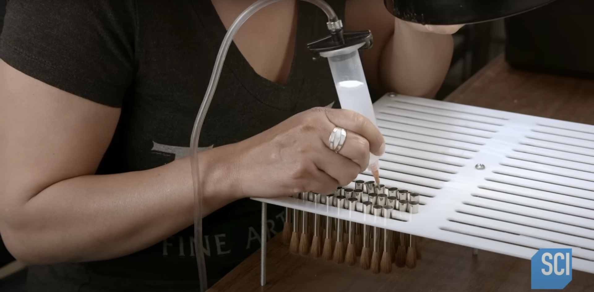
Security’s never enough
Another worker takes care of protecting hairs from getting overboard with epoxy glue.

Slide 9
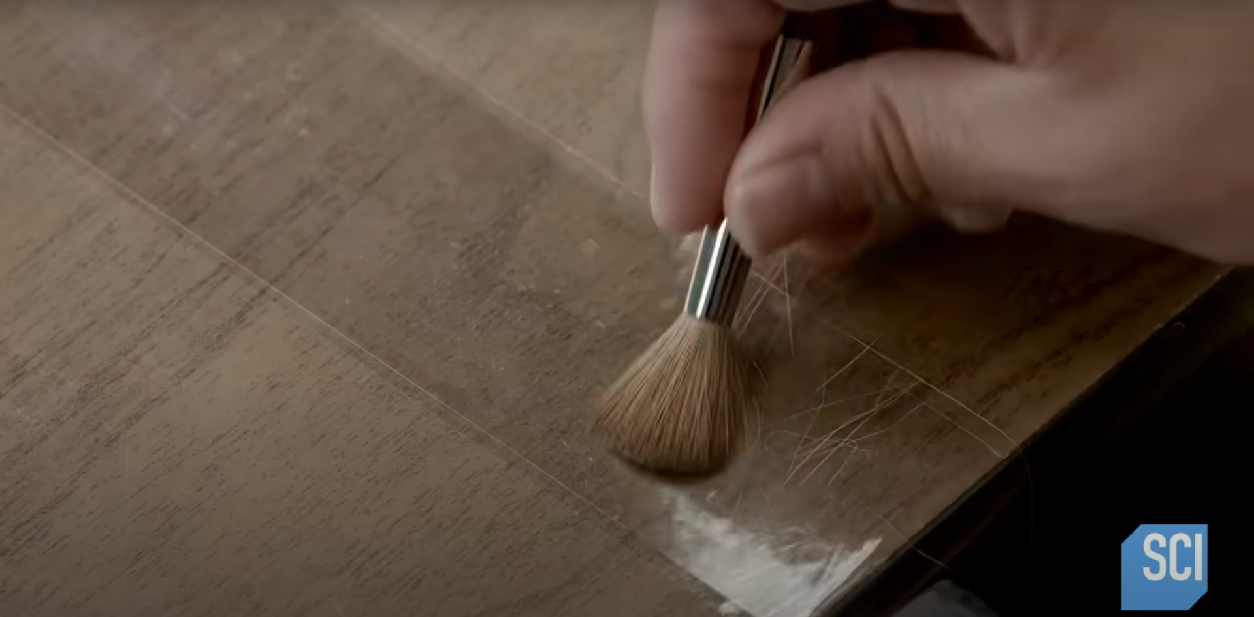
Getting rid of stubborn ones
Those hairs that did not adhere already are being tested by glue tape for endurance

Slide 10
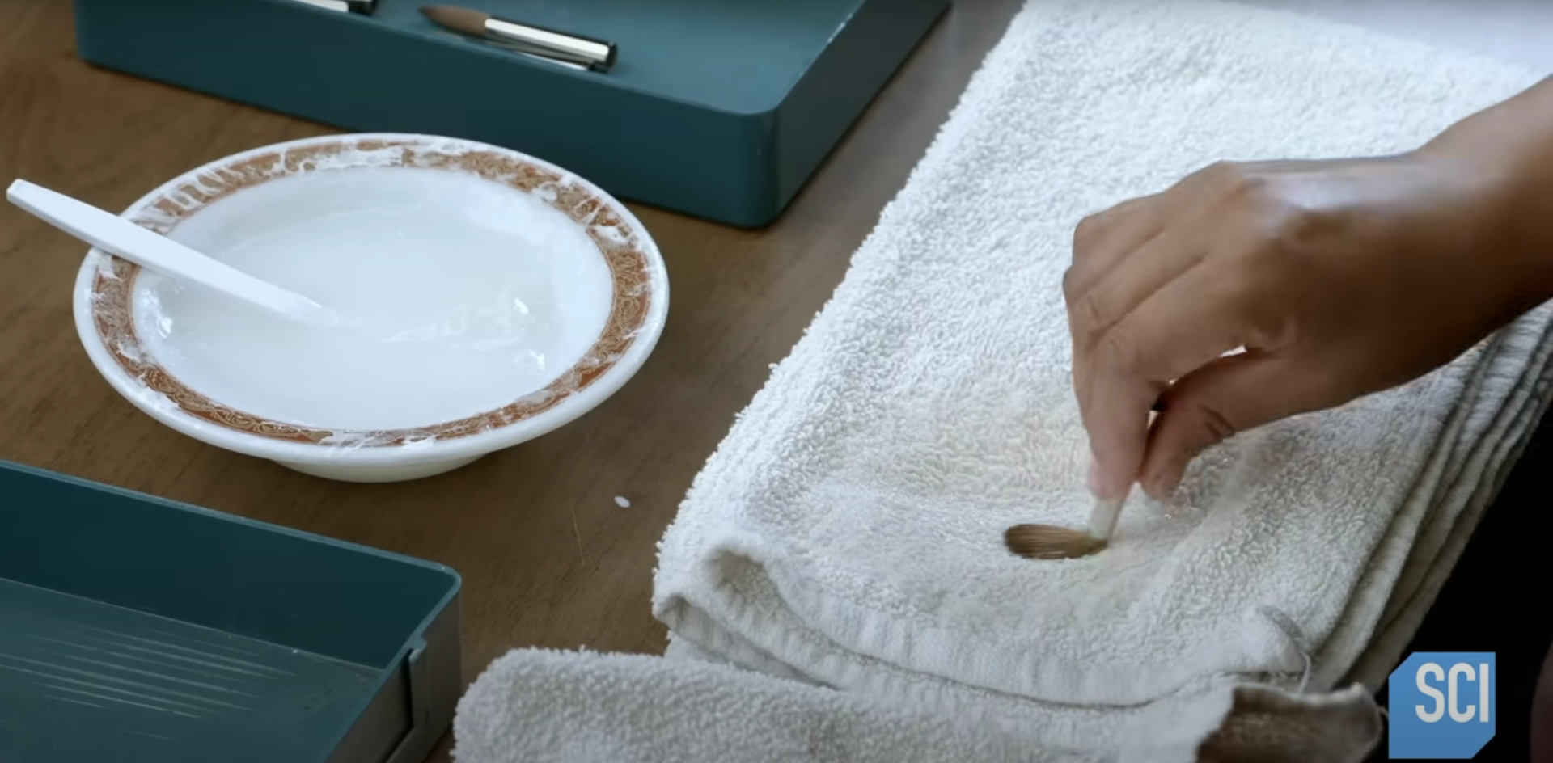
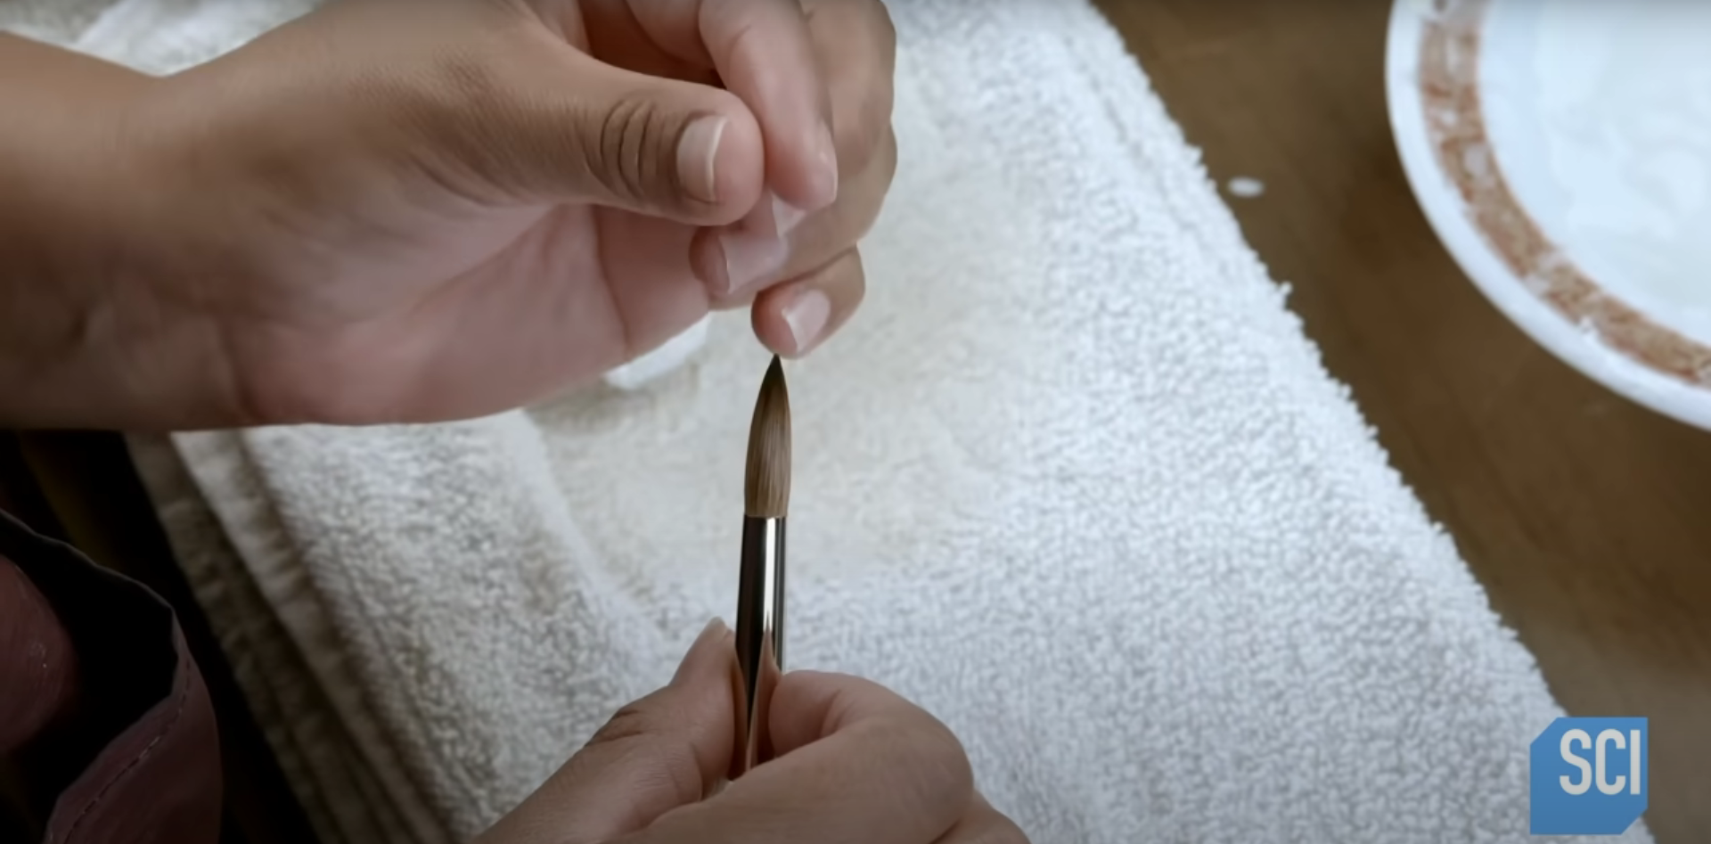
Shape resurrection
All hairs survived are now being formed with a water-starch solution

Slide 11
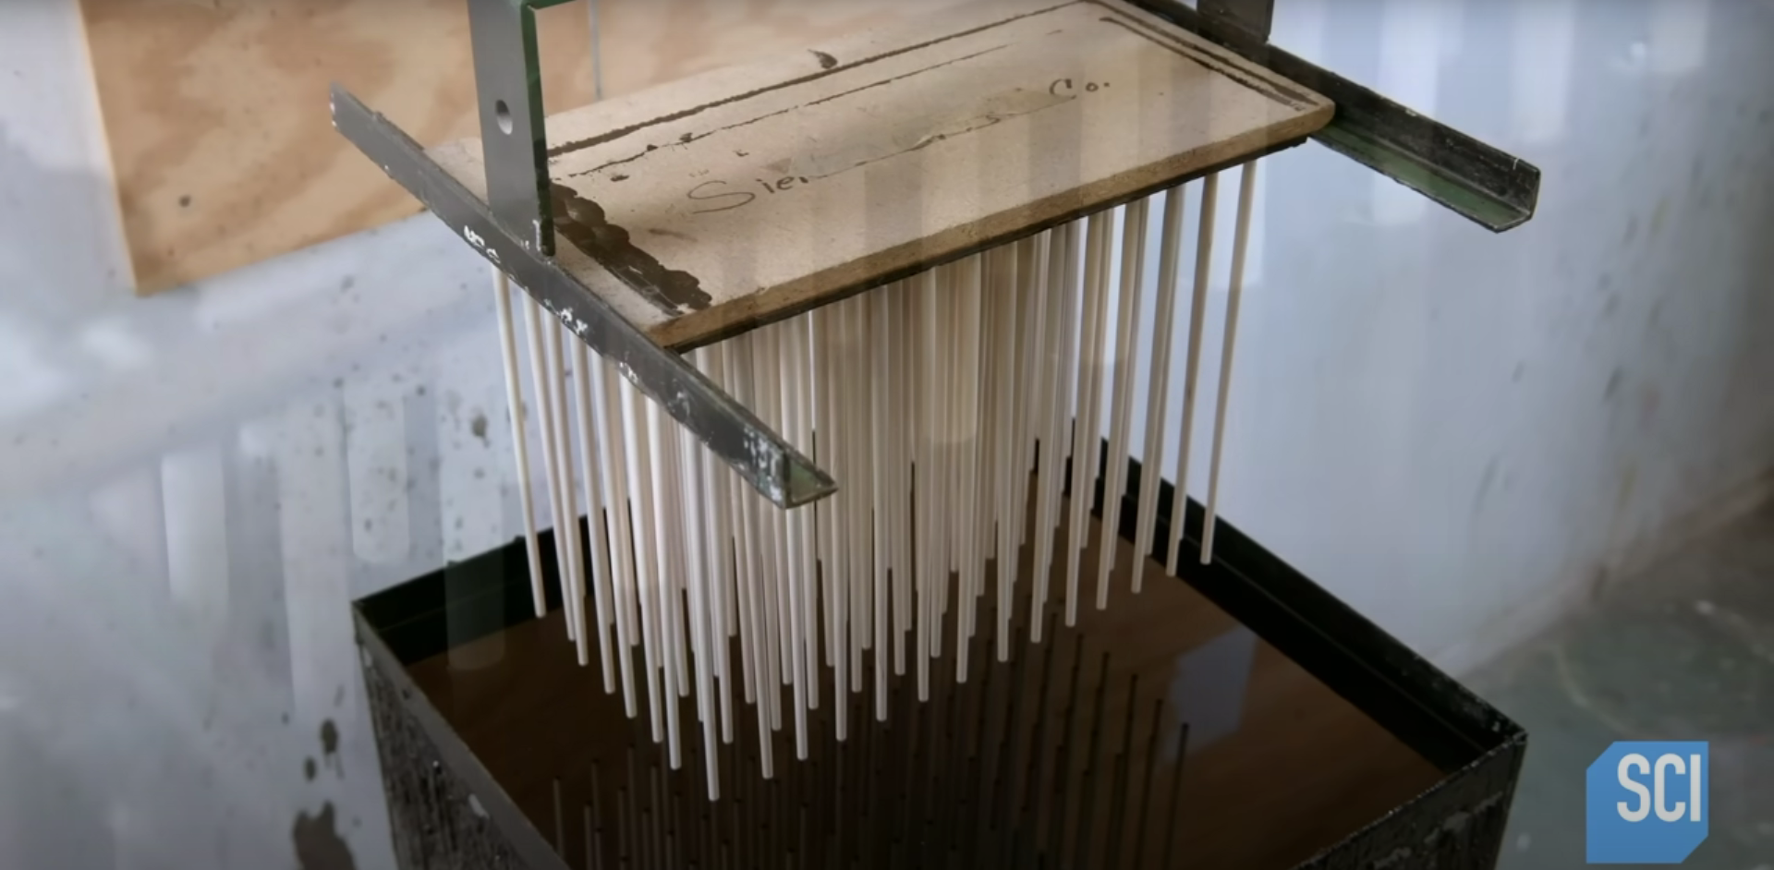
Handle’s next
Mounting handles’ branches to a painting machine

Slide 12
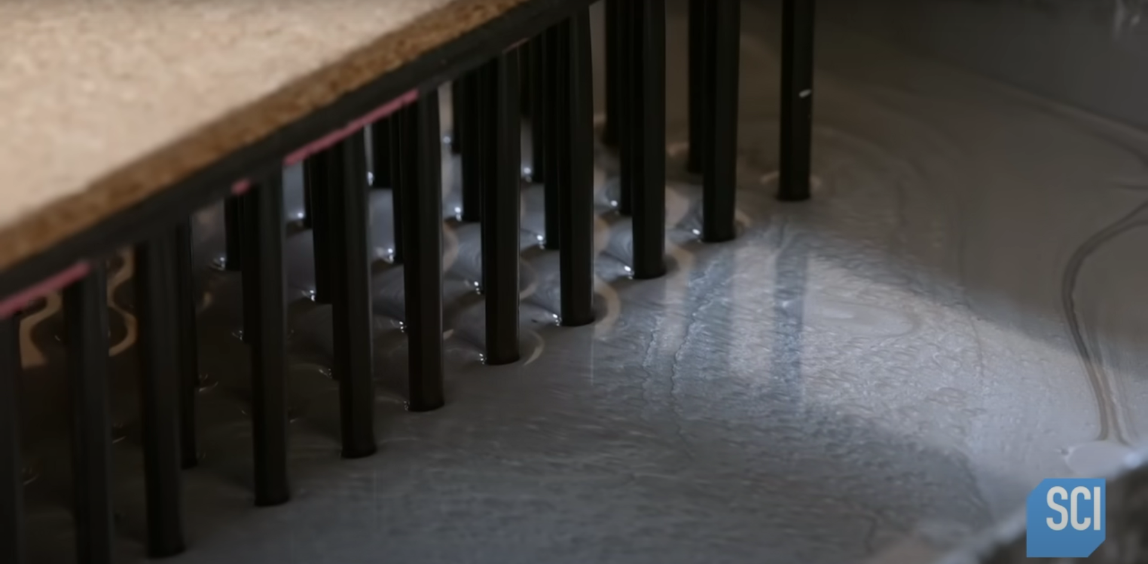
The second dive
Silver paint is added next. (Oh, this fashion…)

Slide 13
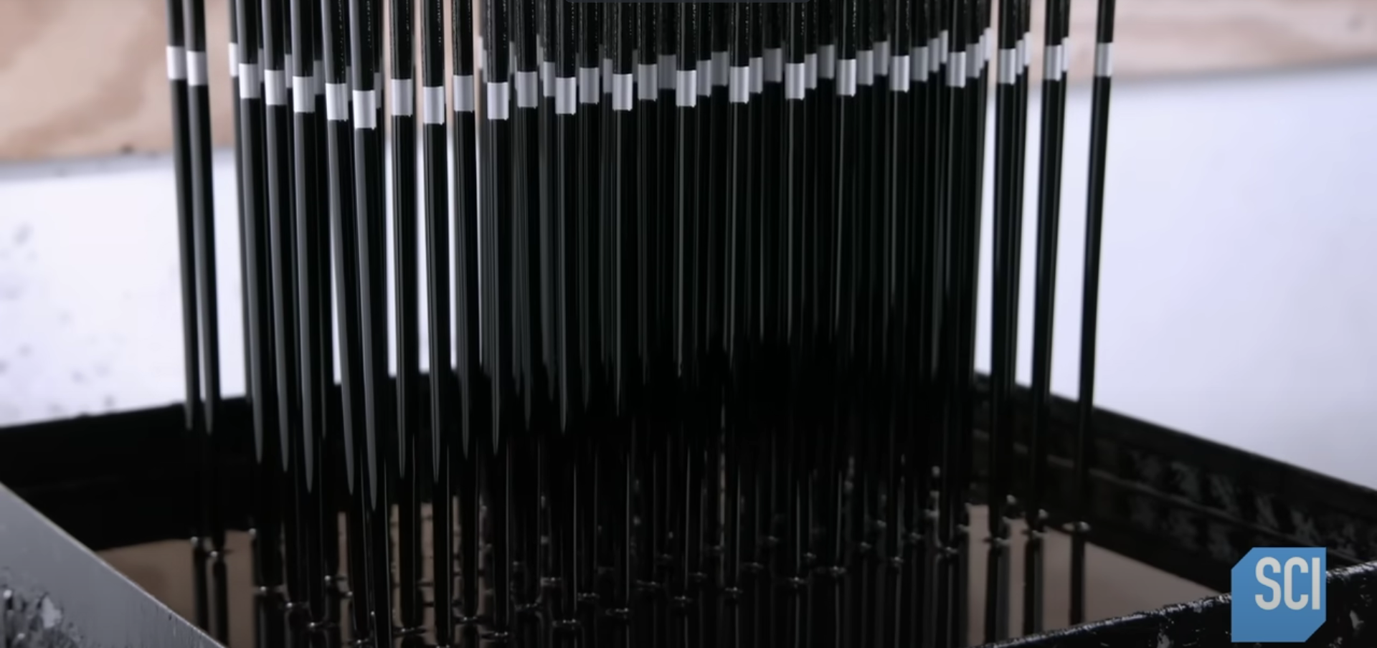
Final dip
This finishes a pattern with silver a line on a handle

Slide 14
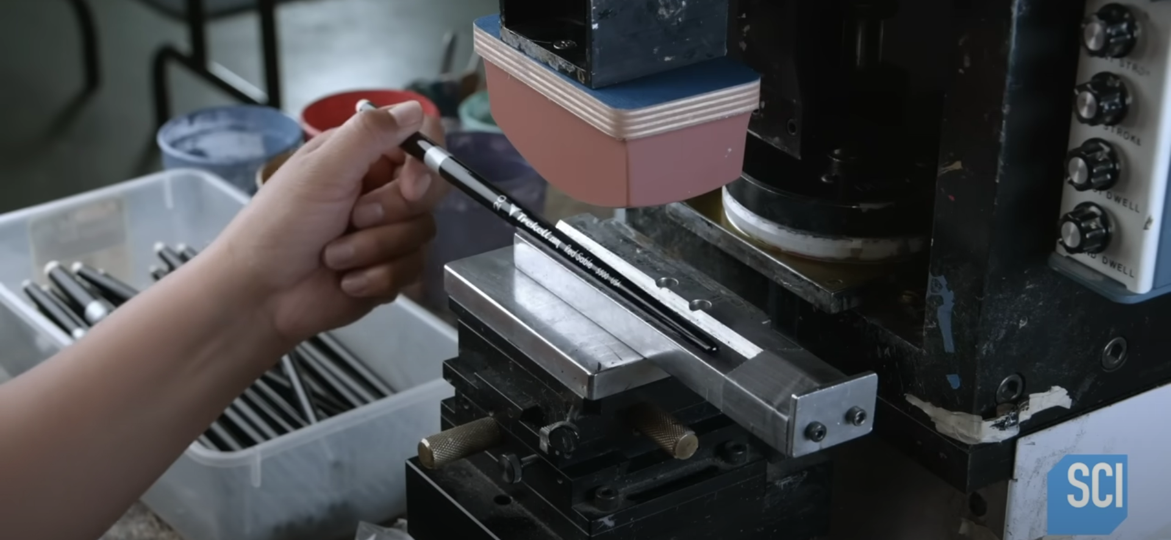
What do they call it
A manly creature comes in action again to set marking. Manufacture’s name, the series, the size, the material are containing here.

Slide 15
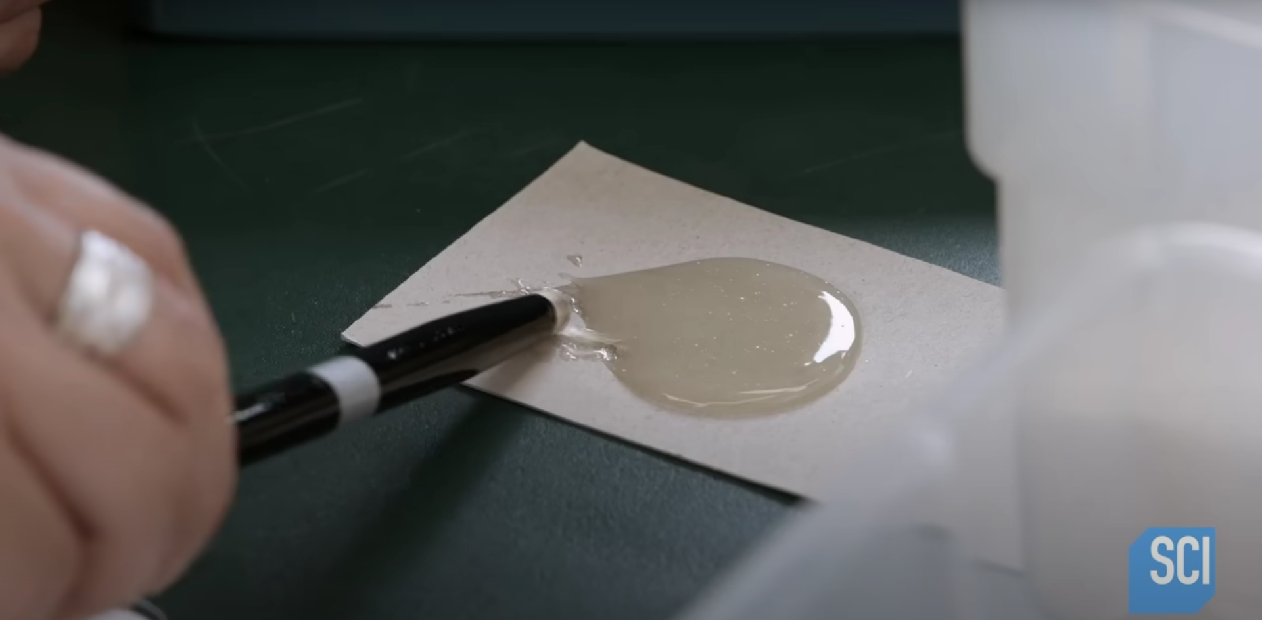
More glue!
Final adhering is applied to connect brush and a handle with glue

Slide 16
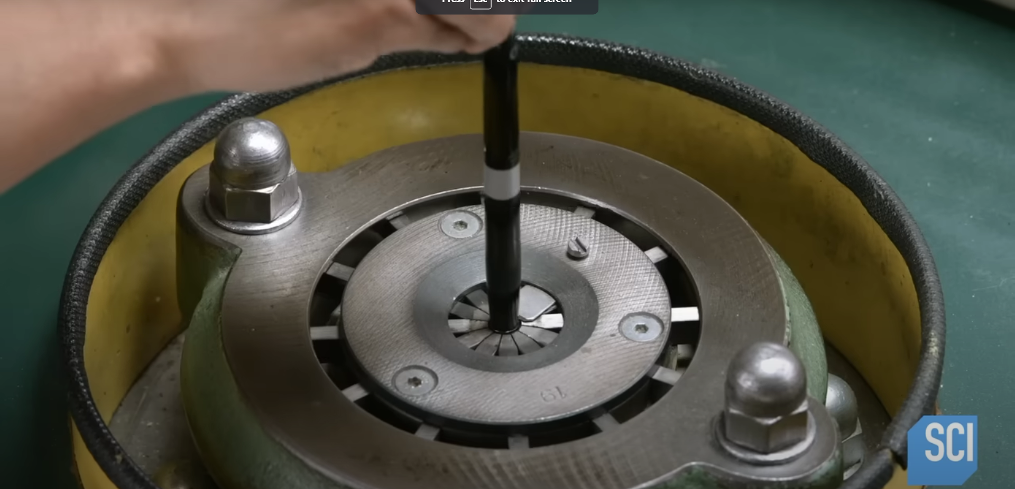
Crimping machine
Final measures taken to mechanically secure the brush

